Slide 1
Requirement analysis for
Movie Recommendation Engine
Md Shamaun Nabi (18201050)
Md. Musfiqur Rahman (18201054)
Al Amin (18201063)
1

Slide 2
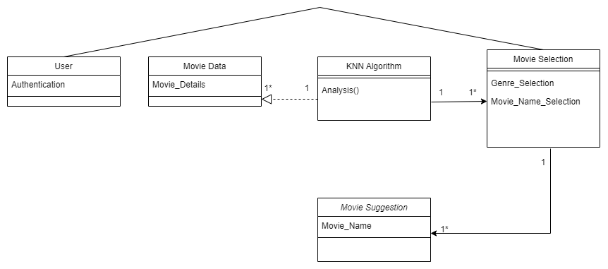
Project
Class-Diagram
02

Slide 3
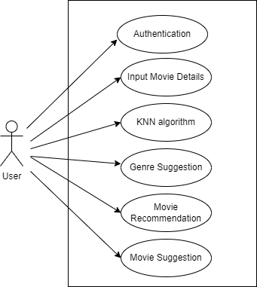
Project
Use Case-Diagram
03

Slide 4
4

